Slide 1
Computer Organization and Assembly Language
Introduction

Slide 2
What is the course about?
This course is about looking at lower level details of how computers works.
In order to do so, we will see computer organization and architecture.
You will also learn assembly language for Intel 8088 processor.
At this point you have taken a course on High level language (C++), so its good time to get started looking at
How processor (CPU) is organized?
How program is executed on processor?
How processor interacts with memory and I/O devices?

Slide 3
Books
Assembly Language Programming Lecture Notes by Bilal Hashmi (BH).
Assembly Language for x86 Processors Seventh Edition Kip R. Irvine (KI)
Computer Organization and Architecture Designing for Performance Tenth Edition by William Stallings (WS)

Slide 4
Tentative Evaluation and Grading Policy
You will be evaluated on quizzes, 2 mid term exams, 1 final exam and multiple assignments.
Quizzes can be unannounced.
Tentative Percentage Grade Distribution:
QUIZZES 10
MIDTERMS 30
FINAL 45
ASSIGNMENTS 15

Slide 5
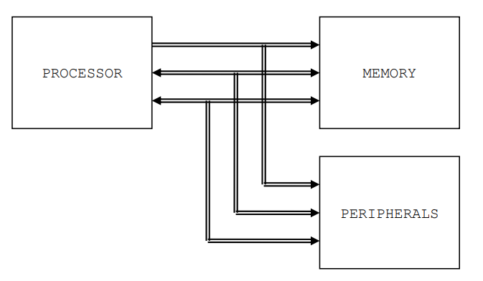
Basic Components of Computer
Section 1.1 BH
Notes:
Processor (CPU)

Slide 6
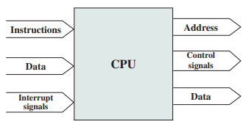
Processor
Processor: The processor reads in instructions and data, writes out data after processing, and uses control signals to control the overall operation of the system. It also receives interrupt signals
Notes:
(Section 3.3 WS)
Arithmetic and Logic Unit (ALU) - A vast array of logic gates, this component deals with basic arithmetic such as binary addition or subtraction. It is capable of many complex mathematical functions, for example sine, cosine and floating point division.
Control Unit (CU) - A component that co-ordinates the various units inside the processor via the use of "control signals" which determine the flow of data into and around the processor. Instructions are decoded in the Control unit during the FDE cycle.

Slide 7
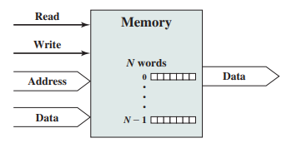
Memory
Memory: Typically, a memory module will consist of N words of equal length. Each word is assigned a unique numerical address (0, 1, c , N-1). A word of data can be read from or written into the memory. The nature of the operation is indicated by read and write control signals. The location for the operation is specified by an address.
Notes:
Page 99 WS (Section 3.3 WS)

Slide 8
Buses
A bus is a communication pathway connecting two or more devices. For example Processor to/from Memory, I/O to/from processor, I/O to/from Memory
The group of bits that the processor uses to inform the memory about which element to read or write is collectively known as the address bus.
Another important bus called the data bus is used to move the data from the memory to the processor in a read operation and from the processor to the memory in a write operation.
The third group consists of miscellaneous independent lines used for control purposes. For example, one line of the bus is used to inform the memory about whether to do the read operation or the write operation. These lines are collectively known as the control bus

Slide 9
A word about registers
Registers are named storage locations in the CPU that hold intermediate results of operations.
As they are located inside CPU they are fastest to access.
Each processor has limited number of registers.

Slide 10
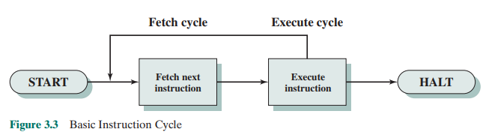
How instructions are executed

Slide 11
Assembly Language
Up till now the instruction you provided to your computer were in High level language, for example code in C++.
But processor doesn’t understand these high level languages. Its only understands 0 or 1. Called machine Language.
Example of machine instruction to add two registers is
Not very meaningful to us humans, image remembering a something like this for so many more instructions!!

Slide 12
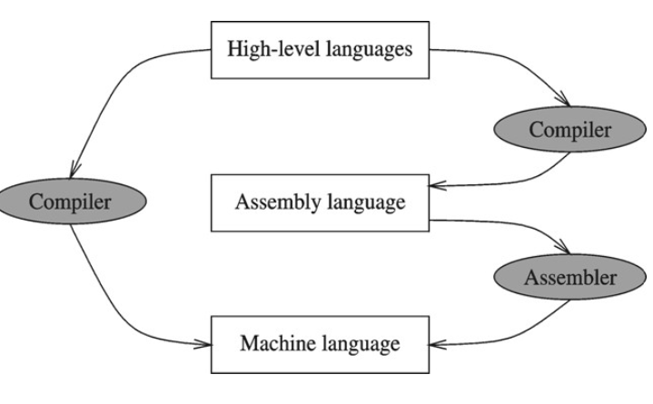
Compiler and Assembler
Some compilers will first convert the code to assembly language and then to machine language (or object code)
Some compilers will directly convert the code to machine language (or object code)
The object code generated is for particular type of processor.

Slide 13
Why need Assembly language?
To better understand the processor.
An assembly language program describes exactly what the hardware should do, step by step, in terms of the basic operations of the hardware. In a high level programming language like C or Java a programmer is mostly unaware of computer architecture.
This can also help in code optimization in terms of space and time.
In some processors it might not be feasible to code in high level languages.

Slide 14
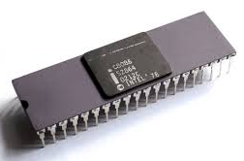
Intel 8086 Processor
There is not just one language called "assembly language.“ Each processor family (such as Intel, VAX, MIPS, Alpha, ...) has its own architecture, organization and machine instructions and a corresponding assembly language.
Learning about one processor and its assembly language is good enough to know how things work.
In this course we will work with intel 8088 16 bit processor, which is a part of inter x86 family of processors.
You will not work with the real processor but with
emulator DosBox
Other tools you will need are assembler and debugger

Slide 15
Instruction Execute Cycle
Instruction
Fetch
Obtain instruction from program storage
Instruction
Decode
Determine required actions and instruction size
Operand
Fetch
Infinite Cycle
Locate and obtain operand data
Execute
Compute result value and status
Writeback
Result
Deposit results in storage for later use

Slide 16
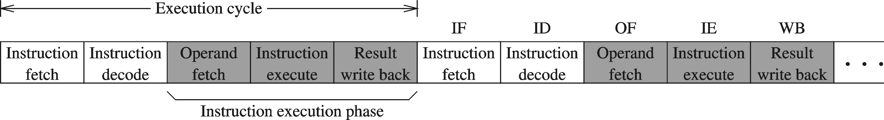
Instruction Execution Cycle – cont'd
Instruction Fetch
Instruction Decode
Operand Fetch
Execute
Result Write back
PC
program
I1
I2
I3
I4
. . .
memory
fetch
op1
read
op2
registers
registers
I1
instruction
queue
decode
write
write
flags
ALU
execute
(output)
Notes:
These concepts will be used in pipelining…..

Slide 17
Instruction Group
Data Movement Instructions
These instructions are used to move data from one place to another.
These places can be registers, memory, or even inside peripheral devices. Some examples are:
mov ax, bx
lda 1234
Arithmetic and Logic Instructions
Arithmetic instructions like addition, subtraction, multiplication, division and Logical instructions like logical and, logical or, logical xor, or complement are part of this group.
Some examples are:
and ax, 1234
add bx, 0534
add bx, [1200]

Slide 18
Instruction Group
Program Control Instructions
These are instructions that control the program execution and flow by playing with the instruction pointer and altering its normal behavior to point to the next instruction.
Some examples are:
cmp ax, 0
jne 1234
Special Instructions
Another group called special instructions works like the special service commandos. They allow changing specific processor behaviors and are used to play with it. They are used rarely but are certainly used in any meaningful program. Some examples are:
cli
sti
Where cli clears the interrupt flag and sti sets it

Slide 19
BASIC OPERAND TYPES
Registers
Uses a named register in the CPU
Example
mov si,cx
add ax,bx
Immediate operands
Constant expressions such as number , character constants or symbols are immediate operands, for example
mov ax,10
add ax,5

Slide 20
BASIC OPERAND TYPES
Direct operands
Refers to the content of memory at a location identified by a label in data segment, for example
mov ax, [num1]
num1: dw 5
Direct offset operand
Refers to the content of memory at a location identified by a label in data segment by +/- a value from offset, for example
mov ax, [num1+1]
num1: dw 5
dw 10
*Note that declaring data will be covered in coming lectures

Slide 21
INTEL IAPX88 ARCHITECTURE

Slide 22
Registers
Types of Registers
Accumulator
Central register in every processor
Traditionally all mathematical and logical operations are performed on the accumulator
n bit processor has n bit accumulator. For example a 16 bit processor has 16 bit accumulator.
Pointer, Index, or Base Register
Holds the address of data
Flag Register
This is a special register in every architecture called the flags register or the program status word.
The bits of the flags register work independently and individually, and combined its value is meaningless.
An example of a bit commonly present in the flags register is the carry flag
If a 16bit number is added to a 16bit accumulator, and the result is of 17 bits the 17th bit is placed in the carry bit of the flags register.
Program Counter or Instruction Pointer
The program counter holds the address of the next instruction to be executed

Slide 23
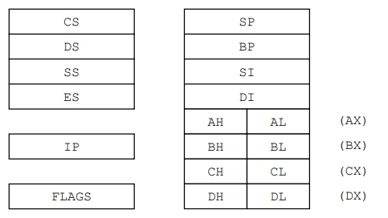
IAPX88 REGISTER ARCHITECTURE
8088 is a 16bit processor with its accumulator and all registers of 16 bits
Consists of 14 registers.
Stack Pointer
Base Pointer
Segment Registers
Index Registers
Instruction Pointer
General Registers
Flags Register

Slide 24
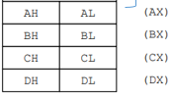
General Registers (AX, BX, CX, and DX)
Used for arithmetic and data movement
X in their names stand for extended meaning 16bit registers
For example AX means we are referring to the extended 16bit “A” register
Upper and lower half can be accessed separately,
For example
AH is for upper 8 bits (A high byte)
AL for lower 8 bits (A low byte)
AX is used to access whole 16 bits
Any changes in AH or AL are reflected in AX.

Slide 25
General Registers (AX, BX, CX, and DX)
AX, A for accumulator, is the accumulator register as it is favored by CPU for arithmetic operations. Provides slightly more efficiency.
BX, B for base, register can hold the address or procedure or variable. BS can also perform arithmetic or data movement.
CX, C for counter, acts as counter for repeating or loop instructions. These instructions automatically repeat and decrement CX.
DX (D for data), has special role in multiply and divide operations, When multiplying, for example, DX holds the high 16 bits of the product.

Slide 26
Index Registers (SI and DI)
SI and DI stand for source index and destination index respectively
Hold address of data and used in memory access.
For flexibility, Intel allows many mathematical and logical operations on these registers as well like the general registers.
The source and destination are named because of their implied functionality as the source or the destination in a special class of instructions called the string instructions.
SI and DI are 16bit and cannot be used as 8bit register pairs like AX, BX, CX, and DX.

Slide 27
Instruction Pointer (IP)
This is the special register containing the address of the next instruction to be executed.
No mathematics or memory access can be done through this register.
It is out of our direct control and is automatically used.
Playing with it is dangerous and needs special care.
Program control instructions change the IP register

Slide 28
Stack Pointer (SP) and Base Pointer (BP)
Stack Pointer (SP) is a memory pointer and is used indirectly by a set of instructions. This register will be explored in the discussion of the system stack.
Base Pointer (BP) It is also a memory pointer containing the address in a special area of memory called the stack and will be explored alongside SP in the discussion of the stack

Slide 29

Flags Register
The flags register as previously discussed is not meaningful as a unit rather it is bit wise significant and accordingly each bit is named separately. The bits not named are unused. The Intel FLAGS register has its bits organized as follows:
The individual flags are explained in the next table.
Empty positions in figure are undefined.

Slide 30
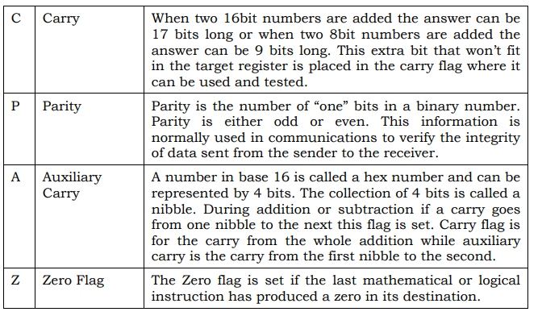
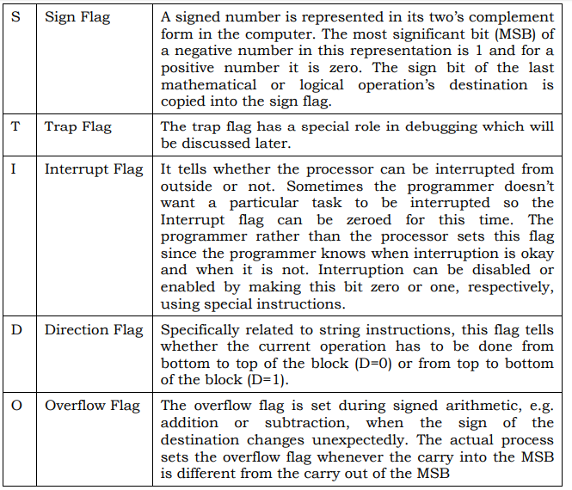

Slide 31
Segment Registers (CS, DS, SS, and ES)
The code segment register, data segment register, stack segment register, and the extra segment register are special registers related to the Intel segmented memory model and will be discussed later.

Slide 32
Bus and Memory
8088 has 8-bit data bus
It has 20 bit address bus
It can access 1MB of memory with this 20 bit address bus
2²⁰ = 1MB

Slide 33
First Program in Assembly language
The first program that we will write will only add three numbers.
The addition operation is performed on data present in registers.
As addition requires two operands, both the operands should be present in registers (or at least one)
The next slide shows the code with comments.

Slide 34
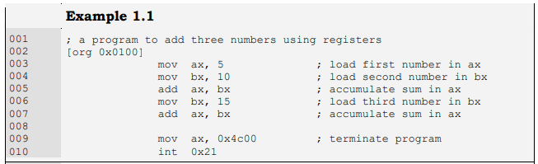
Things to note:
Abbreviations, for example move is written as mov in assembly operation
Code will always start with Line 2 and
Code will always ends with Line 9 and 10 to terminate program safely.
Instructions are written in following format
operation destination, source
Code is very much like English language for example
mov ax,5 means move 5 to ax

Slide 35
Assemble line and Debug code
NASM (Netwide Assembler)will be used to assemble the code and create executable file with .com extension
AFD (A fullscreen debugger) will be used to debug the code.
DOSBox will be used to emulate 8088 processor.
Installation of these tools will be discussed in lab.
Save the code given in previous slide with .asm extension.
Following command will be used to assemble the code
nasm ex01.asm –o ex01.com –l ex01.lst

Slide 36
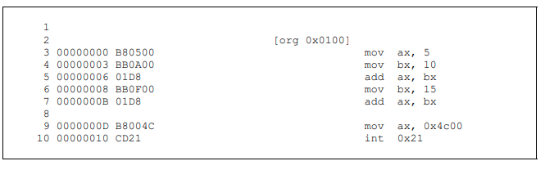
Listing File
The listing file created has a lot of information. And is annotated as follow
Offset of instruction in hex
OPCODE in hex and Operand in little-endian hex
Assemble code
Size of last instruction (line 10) is 2 bytes so total size of .com file is 16+2=18bytes
Notes:
B8 is to move operand to AX
BB is to move operand to BX
Little-endian is an order in which the "little end" (least significant value in the sequence) is stored first

Slide 37
Debug
Following command will be used to debug the file
afd ex01.com
The debugger shows the values of registers, flags, stack, our code, and one or two areas of the system memory as data.
Debugger allows us to step our program one instruction at a time and observe its effect on the registers and program data.

Slide 38
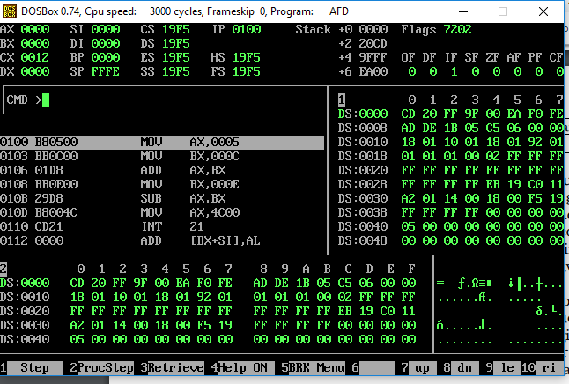
Things to note:
Registers
Memory (m1 and m2 view)
Offset of 1st instruction
IP
Hit F1 to execute instruction
See the change in registers/memory

Slide 39
References
https://sites.google.com/view/coal-fall-2019

